Slide 1
Experts with lived experience
Chair: Prof Debbie Tolson

Slide 2
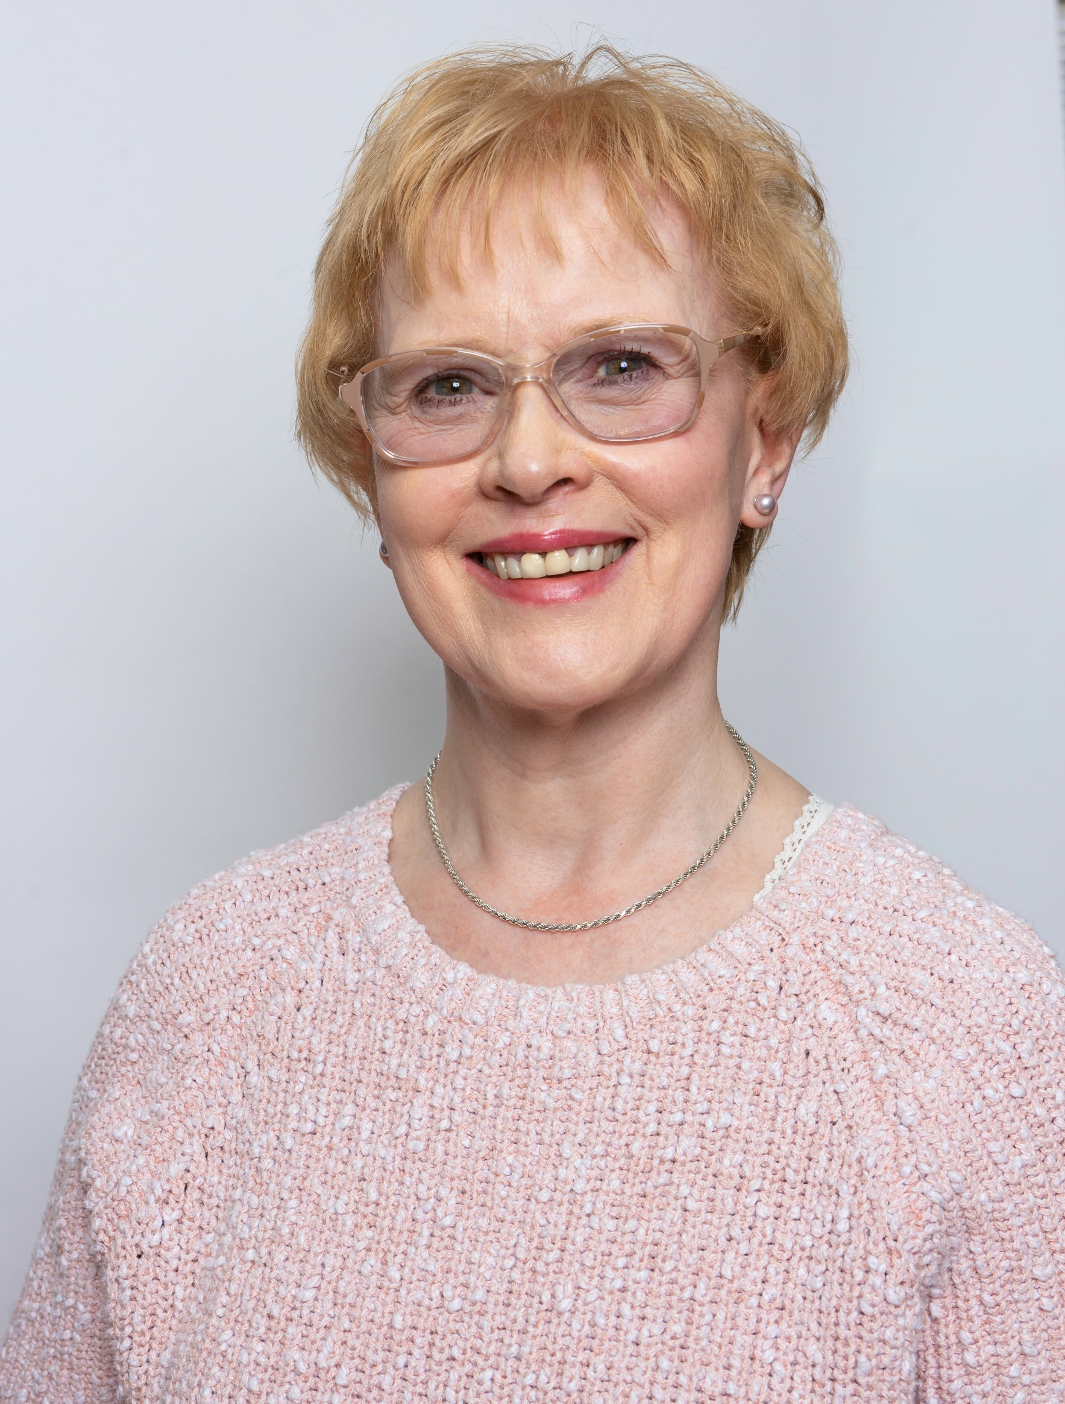
Margaret McCallion
The Scottish Dementia Working Group (SDWG)

Slide 3
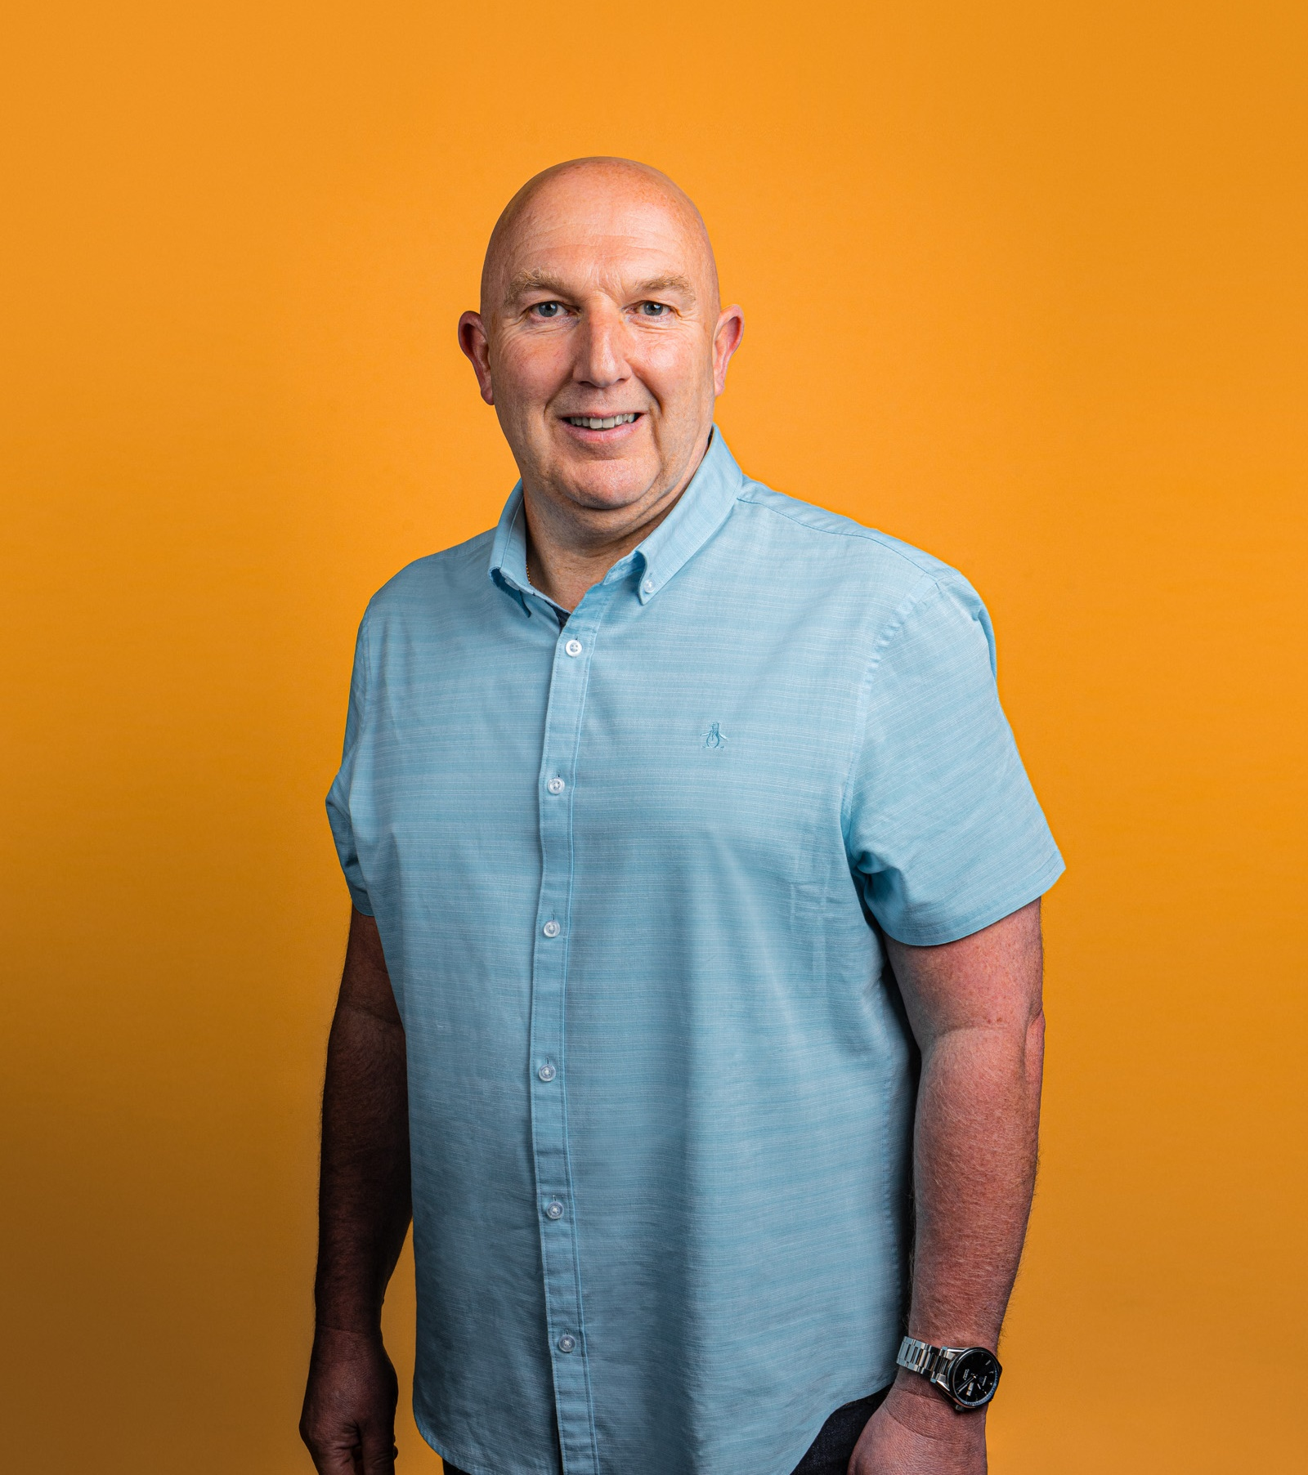
Stuart Dougall
The Scottish Dementia Working Group (SDWG)

Slide 4
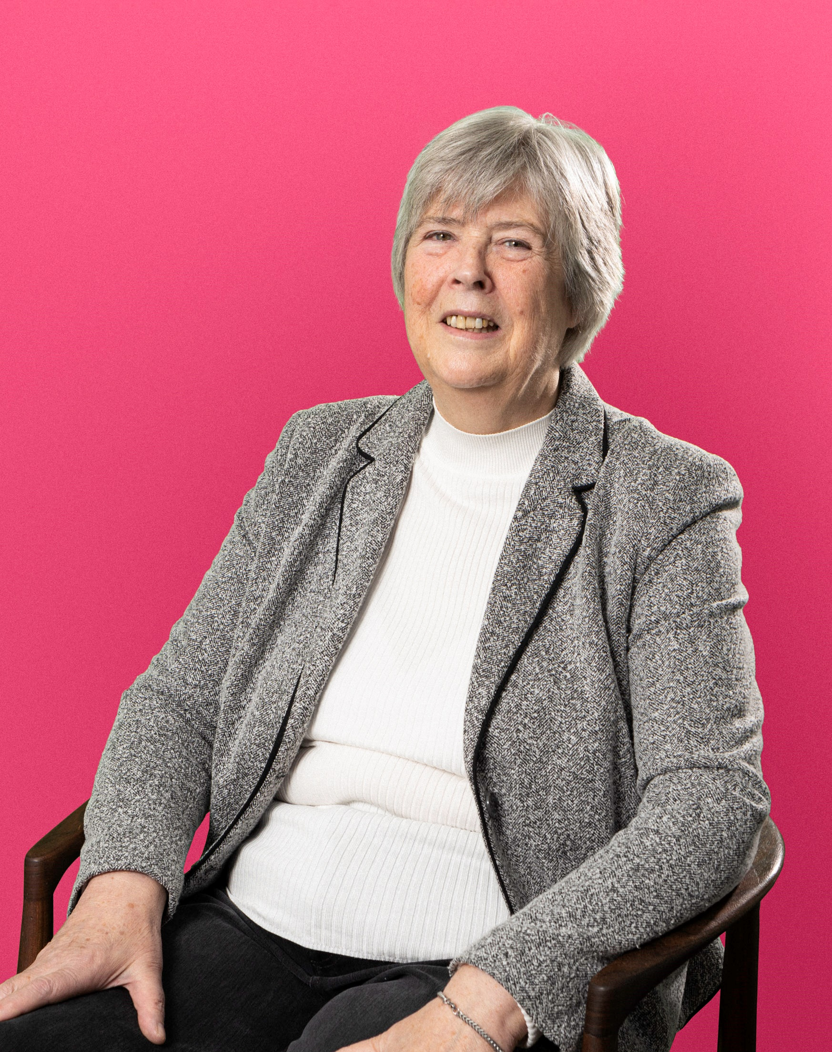
Rynagh Flynn
The Scottish Dementia Working Group (SDWG)

Slide 5
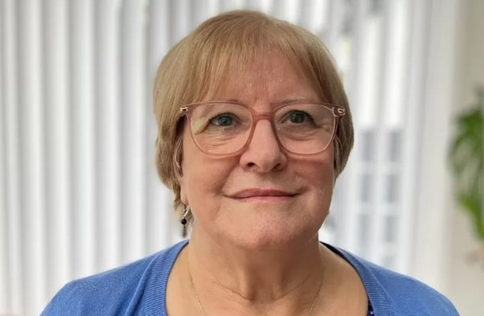
Marion Ritchie
The National Dementia Carers Action Network (NDCAN)

Slide 6
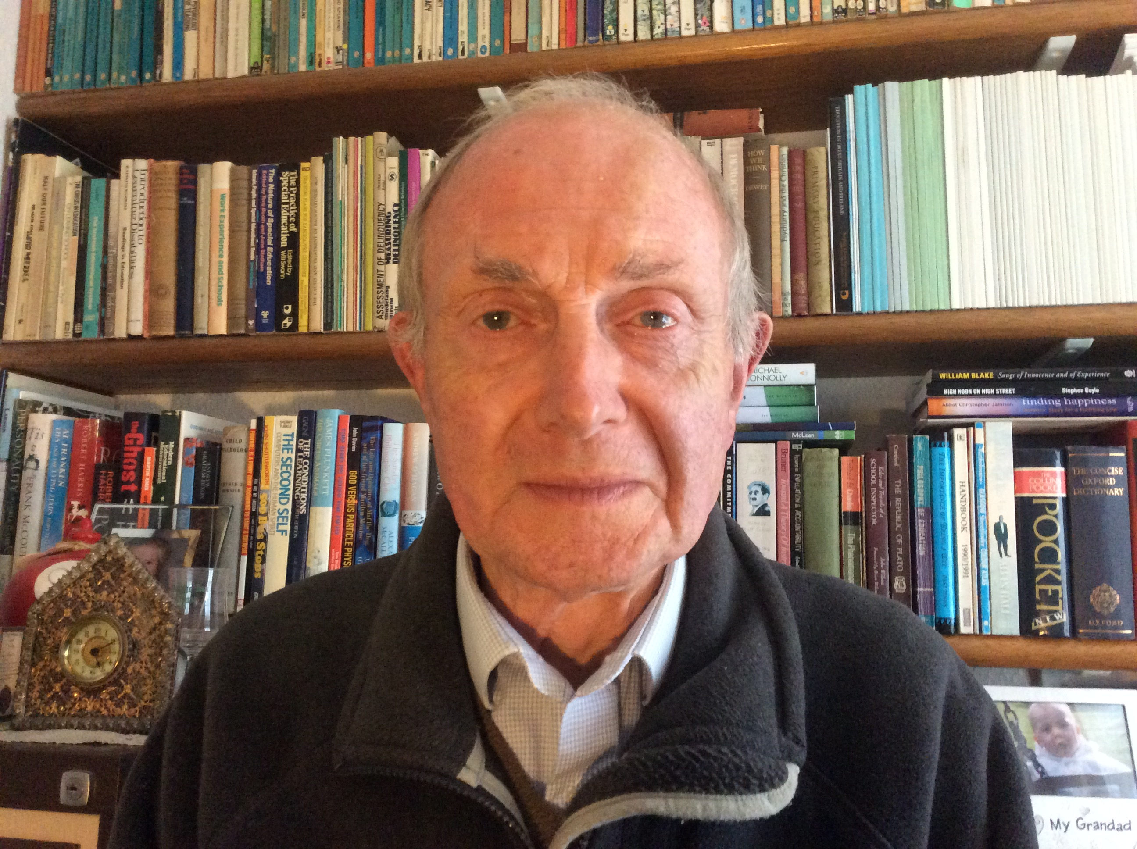
Frank O’Hagan
The National Dementia Carers Action Network (NDCAN)

Slide 7
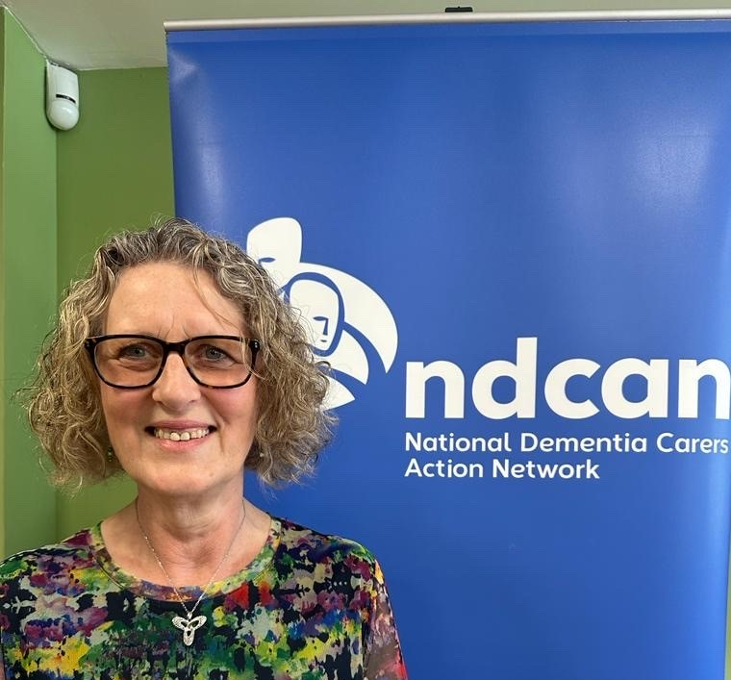
Elaine Deehan
The National Dementia Carers Action Network (NDCAN)

Slide 8
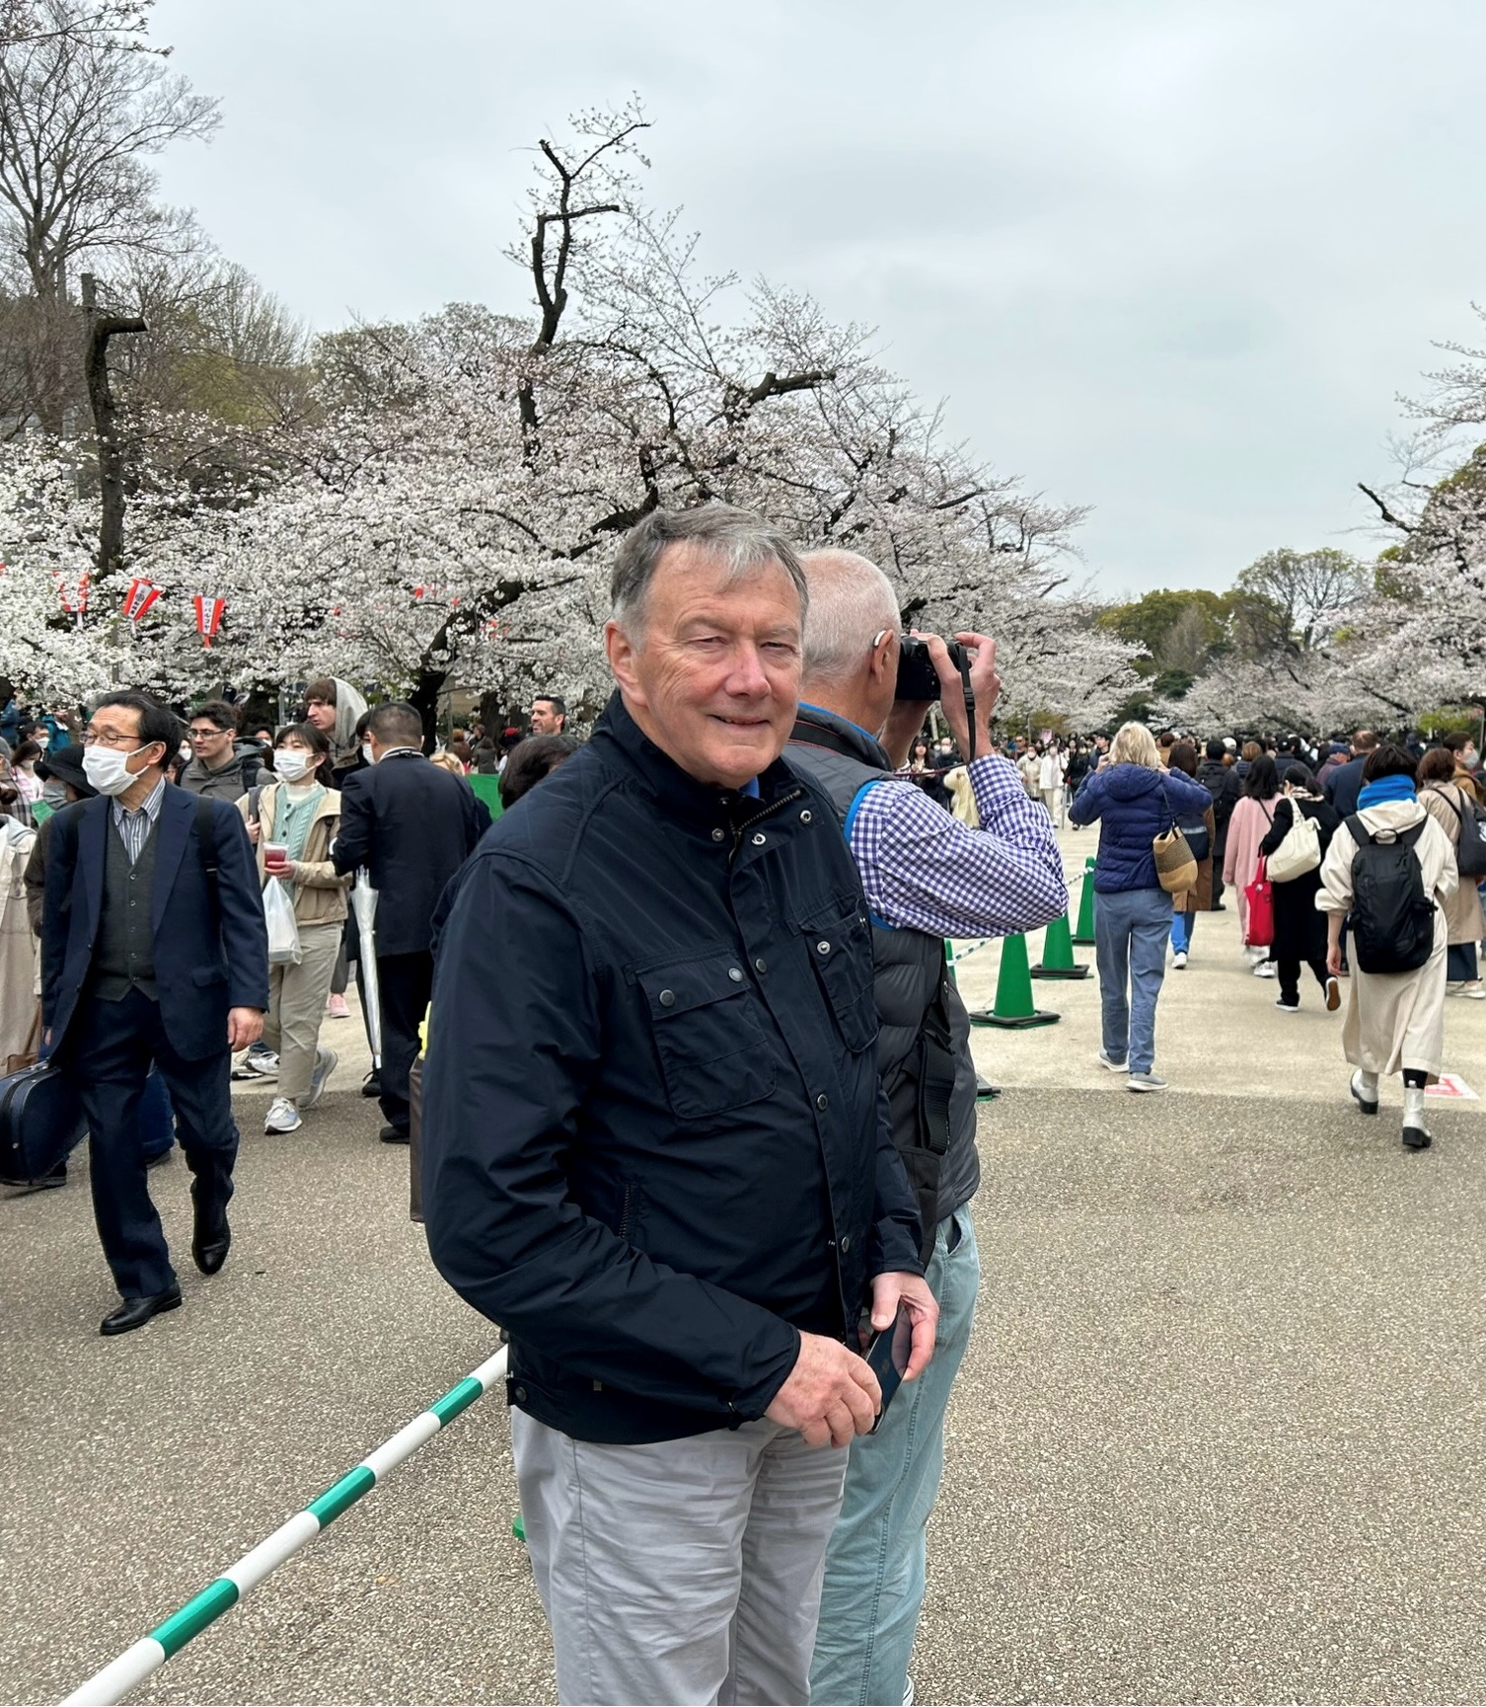
Stephen Brannan Public Patient Involvement In Parkinson’s research

Slide 9
How did I get here?
Diagnosis
Denial
ERIG
Clinical trial
PPI
DUNDEE

Slide 10
My point of view, as a PwP
I WANT IN
I selfishly want something back!
Altruistically I want to help others!
For the research: I want to
understand the hypothesis
help choose the topic
be involved in design & execution
give my data
understand the results

Slide 11
Your point of view, as a researcher
You want to be a groundbreaker!
Altruistically you want to help others!
For the research: you want to
select the participants
gather lots of data
identify trends
analyse results
make recommendations

Slide 12
Questions
Patient | Researcher
Why was I rejected | Have we got the right volunteers
Am I getting better | Are the outcomes as expected
Am I stable | Have we got enough data
Am I deteriorating | Are there adverse side effects
Can I get more of it | Can we implement

Slide 13
Potential Co-Research Projects
How do people react if not chosen
It’s my body – it’s my data
Patients and their carers want feedback
Let’s find out!

Slide 14
Co-production with Lived Experience Researchers
Lindsay Kinnaird
Research and Project Coordinator
School of Health in Social Science | @ECREDementia | ed.ac.uk/ecred

Slide 15
Presentation outline
Introduction to Edinburgh Centre for Research on the Experience of Dementia (ECRED)
What is Co-production
Reflection on Co-production in practice
Some of the structural challenges to Co-production
Moving forward

Slide 16
Introduction to Edinburgh Centre for Research on the Experience of Dementia (ECRED)
Established October 2015 as a social research and learning environment focused on the lived experience of dementia.
Based in the School of Health in Social Science at University of Edinburgh.
Wider remit with international and interdisciplinary collaborations that can have a benefit for people living with dementia.
Co-production and working in partnership with people with lived experience key to ECRED’s work.

Slide 17
What is Co-production?
Research ‘with’ or ‘by’ members of the public rather than ‘to’, ‘about’ or ‘for’ them.
A working together of people with lived experience and researchers.
Valuing all contributions without privileging one type of knowledge over another.
Producing the research together and having co-ownership of it.
Reciprocity and building/maintaining of relationships also important.

Slide 18
Reflection on Co-production in practice
The BUDDs Group (Better Understanding Dementia Diagnosis) co-produced the “Understanding Dementia Diagnosis during the Covid-19 Pandemic” study.
This group is made up of people with lived experience of dementia and researchers.
BUDDs met regularly throughout the project over a 15 month period using an online platform to work together on the planning, analysis and reporting of the study.

Slide 19
Reflection on Co-production in practice
Created a community
Personal knowledge and understanding of lived experience of dementia and broader aspects of the whole person
Provided an ongoing discussion, review and confirmation throughout the research process
Practical aspects and limitations
Outcome and materials enriched

Slide 20
Some of the structural challenges to Co-produced research
Funding application requirements and timescales
Creating change within university system
Short-term contracts and project-to-project working
“On whose terms are we working?” Dementia Enquirers: people with dementia in the driving seat of research (Dementia Journal 2020 Vol 19(1) 68-73)

Slide 22
Moving forward
There is a desire to move towards more sustainable approaches to co-production and leadership for people living with dementia in taking their own projects forward.
Need to embrace the challenges and continue to learn and evolve towards more equitable ways of co-produced dementia research.
“Researchers will come through our door, instead of us entering through theirs!” Dementia Enquirers: people with dementia in the driving seat of research (Dementia Journal 2020 Vol 19(1) 68-73)

Slide 23
Thank you
Lindsay Kinnaird
Research and Project Coordinator
Edinburgh Centre for Research on the Experience of Dementia
School of Health in Social Science | @ECREDementia | ed.ac.uk/ecred

